Slide 1
A brief history of ancient Rome
Kyle Swanson
Notes:
© 2015 Kyle Swanson
Created by Kyle Swanson for ESP HSSP at MIT, Summer 2015
Feel free to use and share this presentation

Slide 2
Why rome?
Notes:
Ask three people why they chose the class
Now I’ll give some of my reasons
One reason is simply vast extent of empire, both in terms of time and land area
Ask for guesses about length of Roman Empire

Slide 3
Why Rome?
Expanse of the Ancient Rome
  Over 1200 years
  5,000,000 km² (1,930,511 sq mi)
Legacy
  Latin
  History
It’s fun!
The Kings (753-510 BCE)
The Republic (510-27 BCE)
The Empire (27 BCE – 476 CE)
Notes:
Compare to age of US, which is not even 250 years old yet (240)
If you include Byzantine Empire, which separated from Roman empire, you get another 1000 years, though we won’t talk much about Byzantine

Slide 4
Why Rome?
Expanse of the Ancient Rome
  Over 1200 years
  5,000,000 km² (1,930,511 sq mi)
Legacy
  Latin
  History
It’s fun!
The Kings (753-510 BCE)
The Republic (510-27 BCE)
The Empire (27 BCE – 476 CE)
Notes:
These are the three periods of Roman history, which we’ll cover throughout the class

Slide 5
Why Rome?
Expanse of the Ancient Rome
  Over 1200 years
  5,000,000 km² (1,930,511 sq mi)
Legacy
  Latin
  History
It’s fun!
The Kings (753-510 BCE)
The Republic (510-27 BCE)
The Empire (27 BCE – 476 CE)

Slide 6
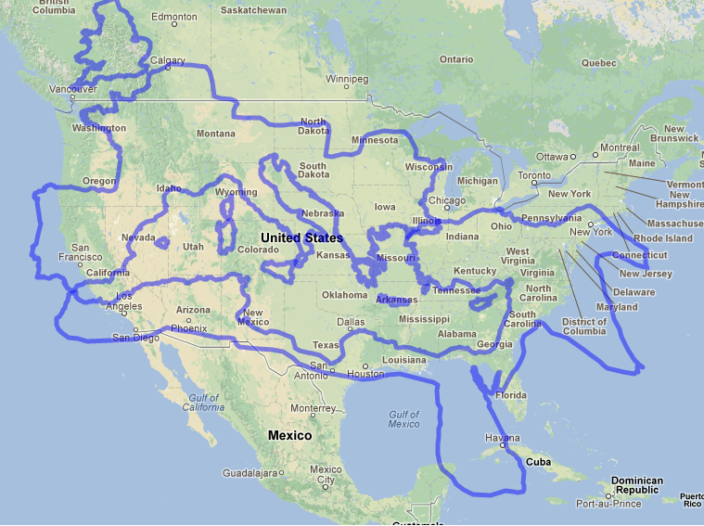
Notes:
To give a sense of the size:
US is nearly twice as large by land, but including the Mediterranean which they controlled they are comparable

Slide 7
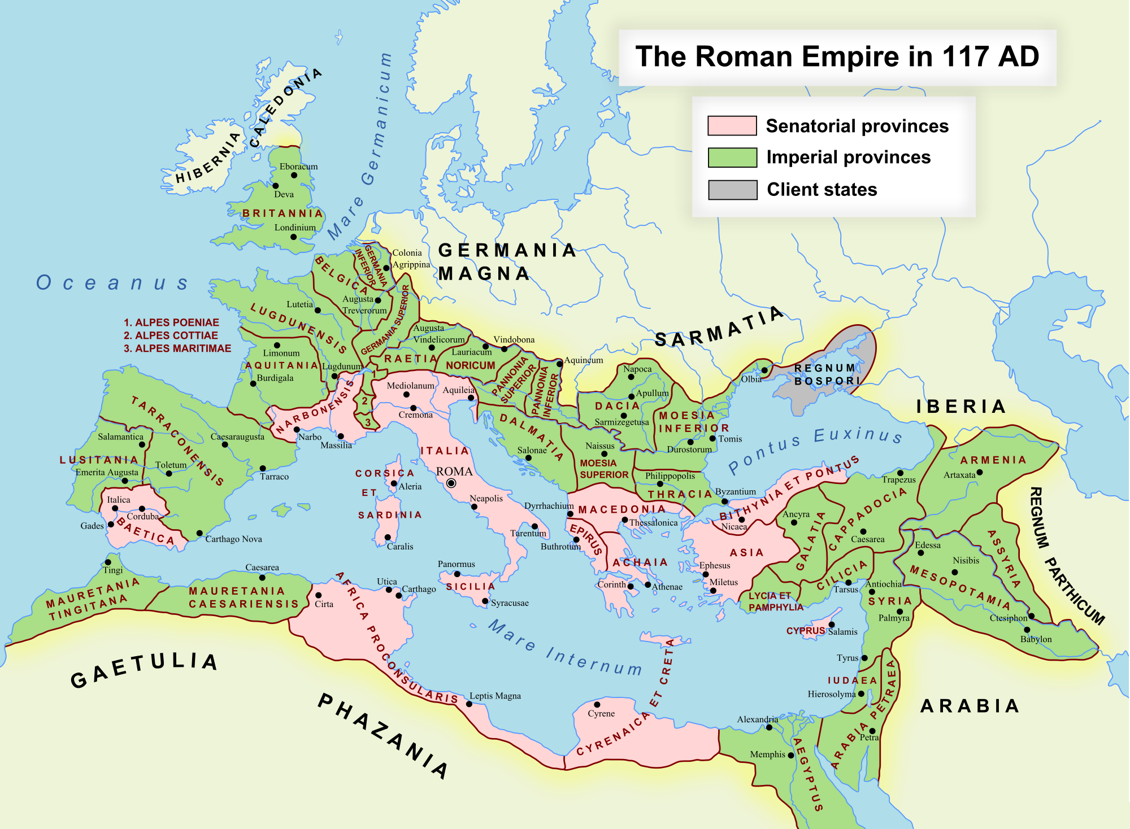
Notes:
Empire at its largest in 117 CE, Trajan
Name some places:
Spain, France, Britain, Italy, Greece, Turkey, Egypt etc.

Slide 8
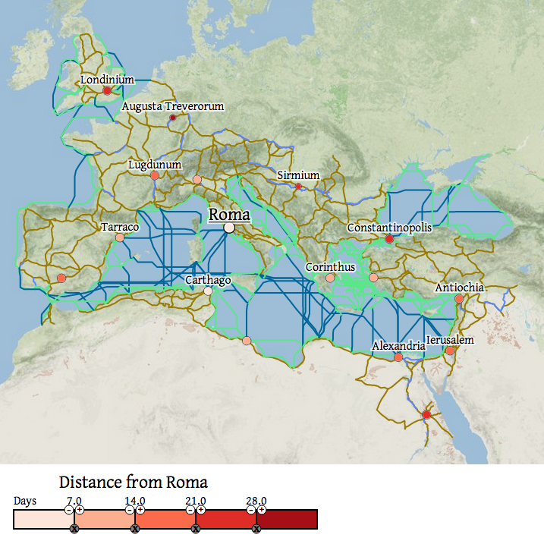
Notes:
Rhetorically ask how long to get from Constantinople to London – answer is a month
Flight today is 3 hour, 45 min
Communication is instant
Impressive thing is how they managed such a large empire with ancient technology

Slide 9
Why Rome?
Expanse of the Ancient Rome
  Over 1200 years
  5,000,000 km² (1,930,511 sq mi)
Legacy
  Latin
  History
It’s fun!
The Kings (753-510 BCE)
The Republic (510-27 BCE)
The Empire (27 BCE – 476 CE)

Slide 10
Why Rome?
Expanse of the Ancient Rome
  Over 1200 years
  5,000,000 km² (1,930,511 sq mi)
Legacy
  Latin
  History
It’s fun!
The Kings (753-510 BCE)
The Republic (510-27 BCE)
The Empire (27 BCE – 476 CE)
Notes:
Ask who takes Spanish, French, Latin etc.
Romance languages: Spanish, Portuguese, French, Italian, Romanian, Catalan
English by derivation
See next slide for map

Slide 11
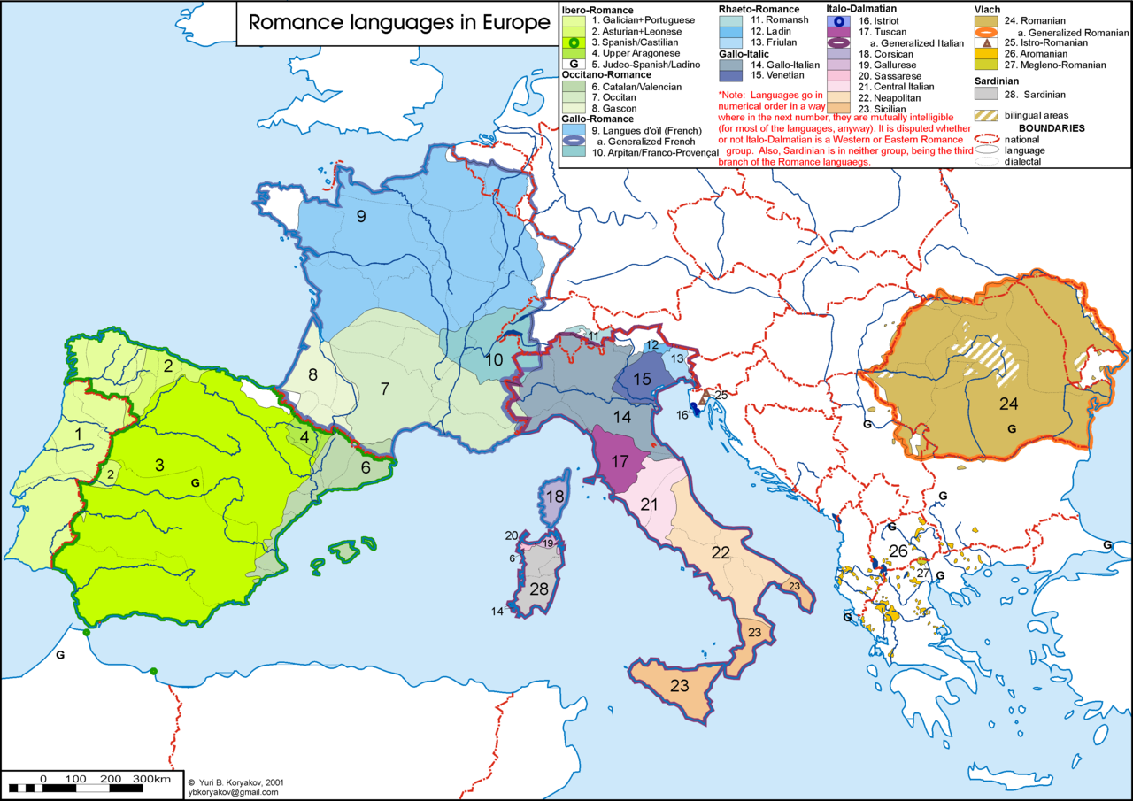
Notes:
Biggest languages are Italian, French, Spanish, Portuguese, Romanian but many other dialects as well

Slide 12
Romance languages
Vulgar Latin | *illa/issa nova lingua
Portuguese | a nova língua
Galician | a nova lingua
Spanish | la nueva lengua
Catalan | la nova llengua
Occitan | la nòva lenga
French | la nouvelle langue
Rhaeto-Romansh | la nova lingua
Sardinian | sa nova limba
Italian | la nuova lingua
Romanian | noua limbă
 | the new language
Notes:
Vulgar Latin was spoken form of non-Classical Latin
Literature in Classical Latin (we’ll see example later)
Notice how similar all the languages are

Slide 13
Why Rome?
Expanse of the Ancient Rome
  Over 1200 years
  5,000,000 km² (1,930,511 sq mi)
Legacy
  Latin
  History
It’s fun!
The Kings (753-510 BCE)
The Republic (510-27 BCE)
The Empire (27 BCE – 476 CE)
Notes:
We constantly look to the republic and the empire in particular to learn what the Romans did right and what mistakes they made so we can avoid them
US democracy largely based on Roman republic, which we’ll see
Founding fathers had read much Roman history

Slide 14
Why Rome?
Expanse of the Ancient Rome
  Over 1200 years
  5,000,000 km² (1,930,511 sq mi)
Legacy
  Latin
  History
It’s fun!
The Kings (753-510 BCE)
The Republic (510-27 BCE)
The Empire (27 BCE – 476 CE)
Notes:
Fun b/c great wars, political scheming, wonderful literature, memorable stories, many movies
One of my favorite stories: Insanity of emperor Caligula (ruled 37-41 CE)
His appointments to the senate were not altogether…normal
Variation I like, explain master of horse (second in command, VP), Caligula wanted horse to be master of horse
(Actual story: Planned to appoint his favorite horse Incitatus as consul and ended up making him a priest)
Horse would “invite” dignitaries to dine with the horse (according to Suetonius’ Lives of the Twelve Caesars (121 CE)

Slide 15
Course outline
Class 1: The Founding of Rome, the Kings, and the Establishment of the Republic (753-264 BCE)
Class 2: Expansion of the Republic (264-82 BCE)
Class 3: The Late Republic and Julius Caesar (82-44 BCE)
Class 4: Rise of Augustus and the Early Empire (44 BCE – 69 CE)
Class 5: Expansion of the Empire (69-235 CE)
Class 6: “Decline and Fall” of the Roman Empire (235-476 CE)
Notes:
Today

Slide 16
Course outline
Class 1: The Founding of Rome, the Kings, and the Establishment of the Republic (753-264 BCE)
Class 2: Expansion of the Republic (264-82 BCE)
Class 3: The Late Republic and Julius Caesar (82-44 BCE)
Class 4: Rise of Augustus and the Early Empire (44 BCE – 69 CE)
Class 5: Expansion of the Empire (69-235 CE)
Class 6: “Decline and Fall” of the Roman Empire (235-476 CE)
Notes:
Rome really starts to grow large
Punic Wars

Slide 17
Course outline
Class 1: The Founding of Rome, the Kings, and the Establishment of the Republic (753-264 BCE)
Class 2: Expansion of the Republic (264-82 BCE)
Class 3: The Late Republic and Julius Caesar (82-44 BCE)
Class 4: Rise of Augustus and the Early Empire (44 BCE – 69 CE)
Class 5: Expansion of the Empire (69-235 CE)
Class 6: “Decline and Fall” of the Roman Empire (235-476 CE)
Notes:
Infamous Caesar who became dictator and played a large role in the collapse of the republic

Slide 18
Course outline
Class 1: The Founding of Rome, the Kings, and the Establishment of the Republic (753-264 BCE)
Class 2: Expansion of the Republic (264-82 BCE)
Class 3: The Late Republic and Julius Caesar (82-44 BCE)
Class 4: Rise of Augustus and the Early Empire (44 BCE – 69 CE)
Class 5: Expansion of the Empire (69-235 CE)
Class 6: “Decline and Fall” of the Roman Empire (235-476 CE)
Notes:
Augustus, first emperor of Rome

Slide 19
Course outline
Class 1: The Founding of Rome, the Kings, and the Establishment of the Republic (753-264 BCE)
Class 2: Expansion of the Republic (264-82 BCE)
Class 3: The Late Republic and Julius Caesar (82-44 BCE)
Class 4: Rise of Augustus and the Early Empire (44 BCE – 69 CE)
Class 5: Expansion of the Empire (69-235 CE)
Class 6: “Decline and Fall” of the Roman Empire (235-476 CE)

Slide 20
Course outline
Class 1: The Founding of Rome, the Kings, and the Establishment of the Republic (753-264 BCE)
Class 2: Expansion of the Republic (264-82 BCE)
Class 3: The Late Republic and Julius Caesar (82-44 BCE)
Class 4: Rise of Augustus and the Early Empire (44 BCE – 69 CE)
Class 5: Expansion of the Empire (69-235 CE)
Class 6: “Decline and Fall” of the Roman Empire (235-476 CE)
Notes:
“Decline and Fall” from Edward Gibbon’s “History of the Decline and Fall of the Roman Empire” 1776-89 (next slide)

Slide 21

Course outline
Class 1: The Founding of Rome, the Kings, and the Establishment of the Republic (753-264 BCE)
Class 2: Expansion of the Republic (264-82 BCE)
Class 3: The Late Republic and Julius Caesar (82-44 BCE)
Class 4: Rise of Augustus and the Early Empire (44 BCE – 69 CE)
Class 5: Expansion of the Empire (69-235 CE)
Class 6: “Decline and Fall” of the Roman Empire (235-476 CE)
Notes:
6 volumes, each about 500 pages long
If Gibbon’s book is that long and it’s only about the end of the empire, clearly I can’t cover everything, but the point of this class is to get the highlights

Slide 22

Class 1 outline
The Founding of Rome, the Kings, and the Establishment of the Republic (753-264 BCE)
  Founding myths:
    The Aeneid
    Romulus and Remus
  The Kings of Rome
  Life in the Republic
  Expansion in Italy
Notes:
Read line then ask people to raise hands if they know what the picture is all about but don’t ask anyone to say what it is…we’ll get there so keep a look out for a wolf

Slide 23
Class 1 outline
The Founding of Rome, the Kings, and the Establishment of the Republic (753-264 BCE)
  Founding myths:
    The Aeneid
    Romulus and Remus
  The Kings of Rome
  Life in the Republic
  Expansion in Italy

Slide 24
Class 1 outline
The Founding of Rome, the Kings, and the Establishment of the Republic (753-264 BCE)
  Founding myths:
    The Aeneid
    Romulus and Remus
  The Kings of Rome
  Life in the Republic
  Expansion in Italy
Notes:
Focus on first and last king

Slide 25
Class 1 outline
The Founding of Rome, the Kings, and the Establishment of the Republic (753-264 BCE)
  Founding myths:
    The Aeneid
    Romulus and Remus
  The Kings of Rome
  Life in the Republic
  Expansion in Italy
Notes:
With a focus on laws and Roman values

Slide 26
Class 1 outline
The Founding of Rome, the Kings, and the Establishment of the Republic (753-264 BCE)
  Founding myths:
    The Aeneid
    Romulus and Remus
  The Kings of Rome
  Life in the Republic
  Expansion in Italy
Notes:
Quickly mention some of the early wars Rome fought as it expanded from a small city to a state in control of most of Italy

Slide 27
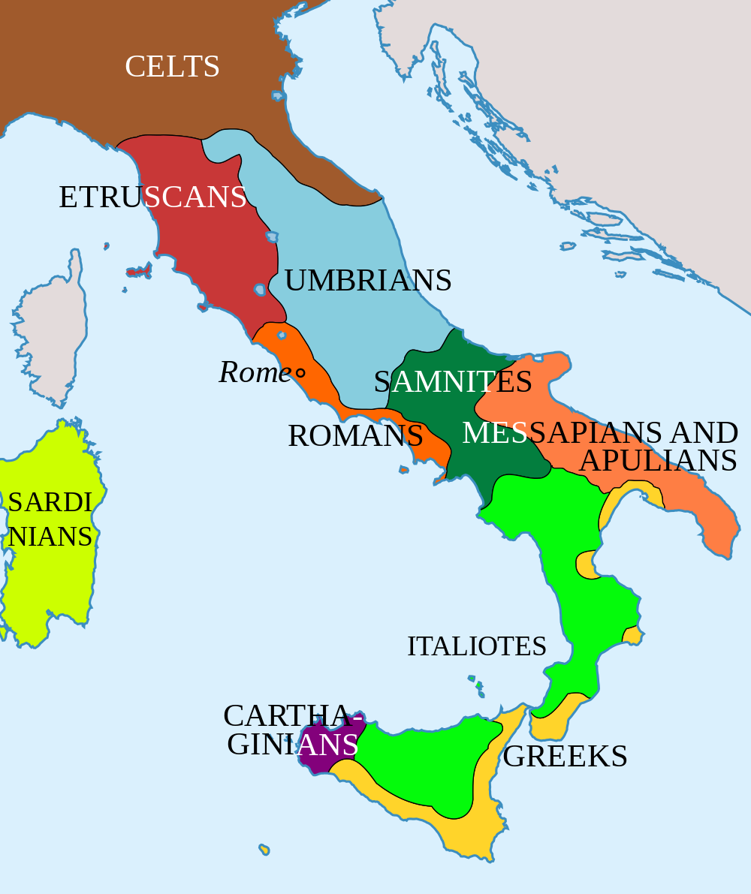
Notes:
This is where we start
In reality the Romans were just one of many peoples living in Italy that slowly established itself as a power in Italy
But the Romans prefer to think that they were descended from a race of people chosen by the gods and even born of the gods
So first tell about gods and goddesses and then we’ll get to Aeneas

Slide 28
Roman mythology
Roman | Greek | Role
 |  | King of the gods – sky and air
 |  | Queen of the gods – marriage
 |  | Goddess of beauty
 |  | God of war
 |  | God of poetry, music, sun
 |  | God of the sea
 |  | Goddess of the hearth
 |  | Messenger of the gods
 |  | Goddess of hunting
 |  | Goddess of wisdom
 |  | God of blacksmiths
 |  | Goddess of the harvest, nature
Notes:
Ask people to name gods and goddesses

Slide 29
Roman mythology
Roman | Greek | Role
Jupiter | Zeus | King of the gods – sky and air
Juno | Hera | Queen of the gods – marriage
Venus | Aphrodite | Goddess of beauty
Mars | Ares | God of war
Apollo | Apollo | God of poetry, music, sun
Neptune | Poseidon | God of the sea
Pluto | Hades | God of the underworld
Mercury | Hermes | Messenger of the gods
Diana | Artemis | Goddess of hunting
Minerva | Athena | Goddess of wisdom
Vulcan | Hephaestus | God of blacksmiths
Ceres | Demeter | Goddess of the harvest, nature
Notes:
12 major gods and goddesses, based on Greek deities (many connections between Rome and Greece)
Planets based on Roman gods
Ceres = cereal

Slide 30
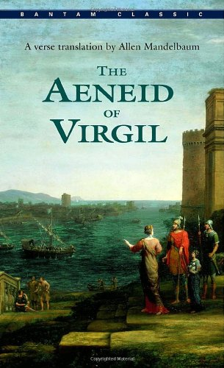
aeneid
Aeneid
  Written by Virgil between 29 and 19 BCE (early Empire)
  Aeneas, a Trojan prince whose descendants were the Romans
  Like Homer’s Iliad and Odyssey
  12 books
    1-6 Journey to Italy
    7-12 War in Italy
Notes:
Almost 10,000 line poem

Slide 31
aeneid
Aeneid
  Written by Virgil between 29 and 19 BCE (early Empire)
  Aeneas, a Trojan prince whose descendants were the Romans
  Like Homer’s Iliad and Odyssey
  12 books
    1-6 Journey to Italy
    7-12 War in Italy
Notes:
All myth as far as we know, but believed by the Romans because they wanted to think they had divine origins (Aeneas’s mother was the goddess Venus)

Slide 32
aeneid
Aeneid
  Written by Virgil between 29 and 19 BCE (early Empire)
  Aeneas, a Trojan prince whose descendants were the Romans
  Like Homer’s Iliad and Odyssey
  12 books
    1-6 Journey to Italy
    7-12 War in Italy
Notes:
Raise hands if know Odyssey
Raise hands if know Aeneid
Iliad – 10 year war between Troy and Greece (end is where Aeneid starts)
Odyssey – Odysseus’ 10 year travels home through many adventures
Aeneid is that but other way around

Slide 33
aeneid
Aeneid
  Written by Virgil between 29 and 19 BCE (early Empire)
  Aeneas, a Trojan prince whose descendants were the Romans
  Like Homer’s Iliad and Odyssey
  12 books
    1-6 Journey to Italy
    7-12 War in Italy

Slide 34
Opening lines
Latin | English
Arma virumque cano Troiae qui primus ab oris
Italiam fato profugus Lavinia venit
Littora: multum ille et terres iactatus et alto
Vi superum saevae memorem Iunonis ob iram.
Multa quoque et bello passus dum conderet urbem
Inferretque deos Latio: genus unde Latinum
Albanique patres atque altae moenia Romae.
Notes:
Read first line
Does anyone know the first line?
No j
K only for Greek words
No y
Hard c’s
V’s like w’s so no v sound and no w letter
So we usually pronounce names wrong: Cicero, Julius Caesar
Latin actually written with no spaces or punctuation (see next slide)

Slide 35
Opening lines
Latin | English
ARMAVIRUMQUECANOTROIAEQUIPRIMUSABORISITALIAMFATOPOFUGUSLAVINIAVENIT.LITTORAMULTUMILLEETTERRESIACTATUSETALTOVISUPERUMSAEVAEMEMOREMIUNONISOBIRAMMULTAQUOQUEETBELLOPASSUSDUMCONDERETURBEMINFERRETQUEDEOSLATIOGENUSUNDELATINUMALBANIQUEPATRESATQUEALTAEMOENIAROMAE

Slide 36
Opening lines
Latin | English
Arma virumque cano Troiae qui primus ab oris | I sing of arms and the man, he who, exiled by fate,
Italiam fato profugus Lavinia venit | First came from the coast of Troy to Italy, and to
Littora: multum ille et terres iactatus et alto | Lavinian shores – hurled about endlessly by land and sea
Vi superum saevae memorem Iunonis ob iram. | By the will of the gods, by cruel Juno’s remorseless anger,
Multa quoque et bello passus dum conderet urbem | Long suffering also in war, until he founded a city
Inferretque deos Latio: genus unde Latinum | And brought his gods to Latium: from the Latin people
Albanique patres atque altae moenia Romae. | Came, the lords of Alba Longa, the walls of noble Rome.
Notes:
Gives very brief overview of whole poem
Read first line

Slide 37
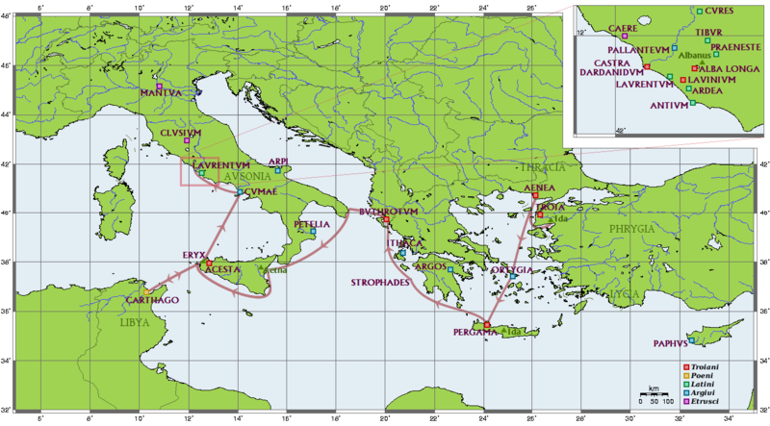
Notes:
Journey to Italy in Books 1-6
Start in Troy
Big stop in Carthage, Dido
Cumae and oracle, underworld
Arrives in Laurentum where Rome will eventually be founded

Slide 38
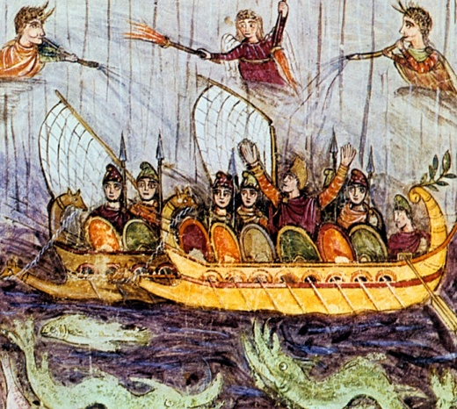
Journey to italy
Shipwrecked by Juno at Carthage
Retelling of the fall of Troy
Dido and Aeneas
Aeneas in the underworld
Notes:
In medias res, analogy to Indiana Jones etc.
Juno has longstanding hatred of Trojans for a variety of reasons (Paris chose Venus over her, Romans will eventually destroy Carthage)
Venus sends Mercury to help Aeneas sneak into Carthage where he meets Queen Dido

Slide 39
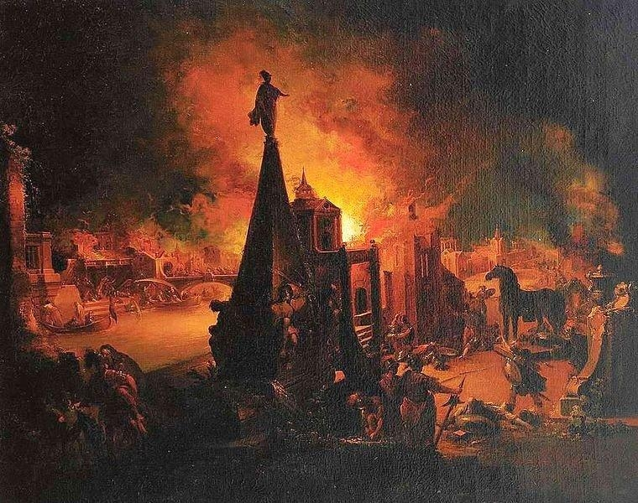
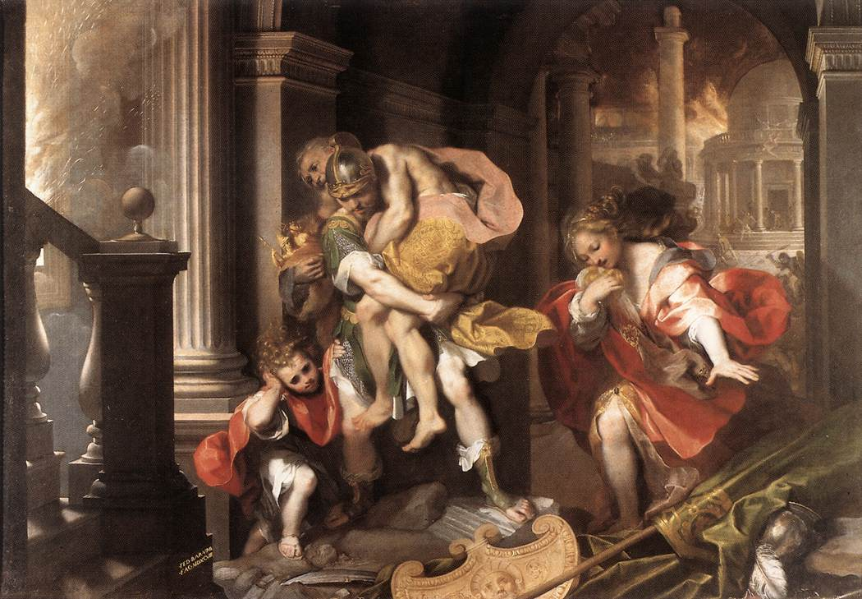
Journey to italy
Shipwrecked by Juno at Carthage
Retelling of the fall of Troy
Dido and Aeneas
Aeneas in the underworld
Notes:
Trojan horse and Laocoon, serpents
Invasion of the Greeks
Death of Priam
Escape of Aeneas

Slide 40
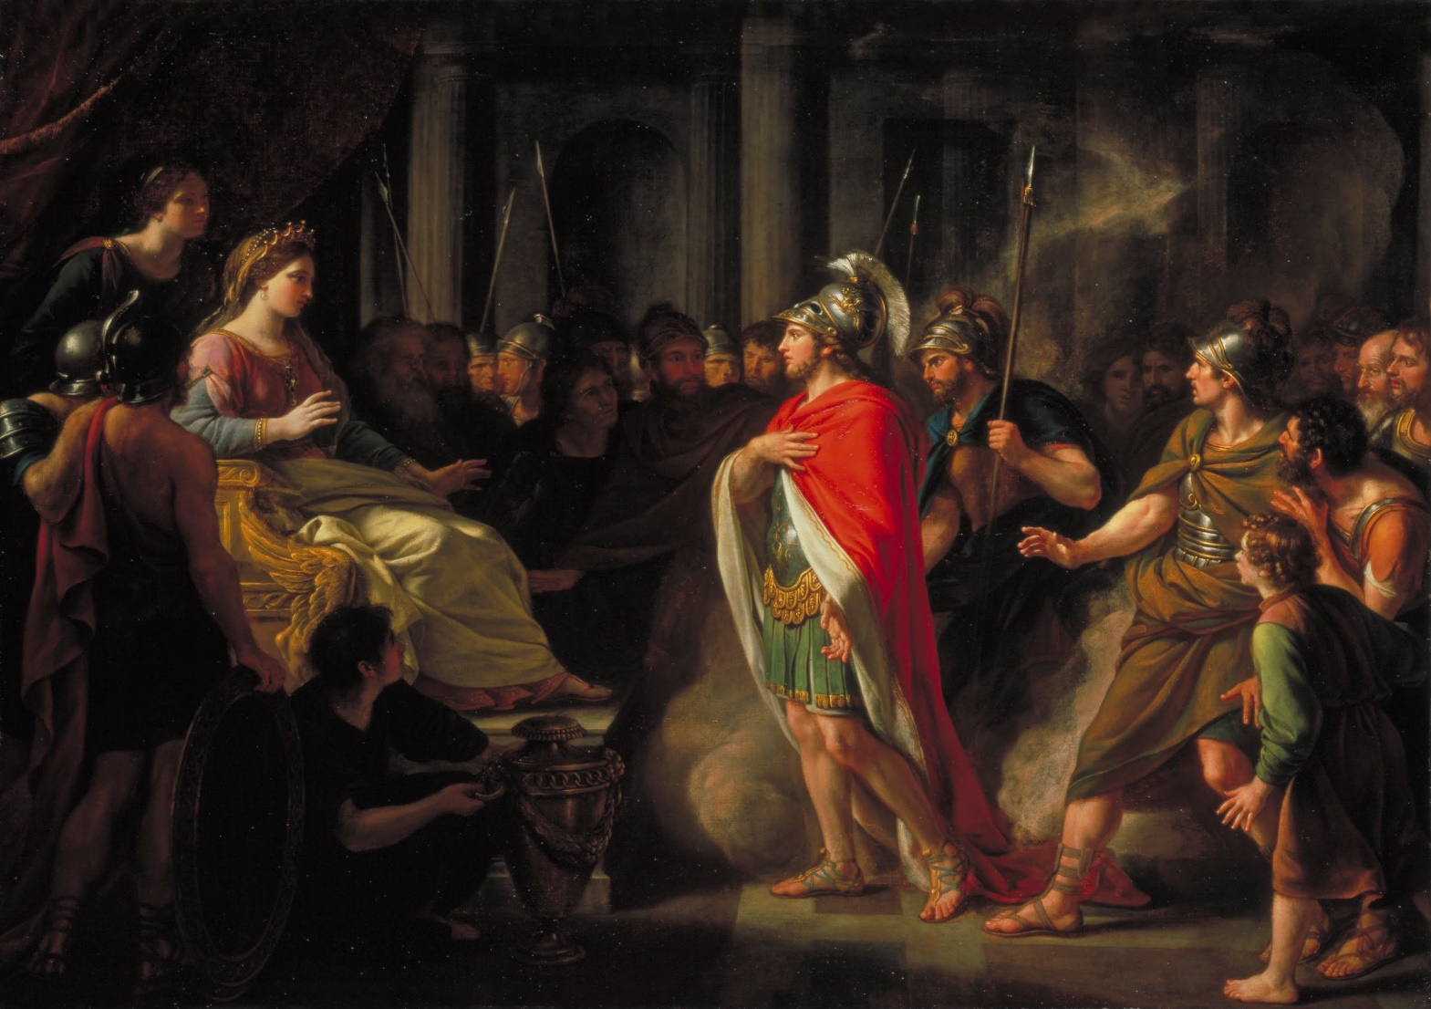
Journey to italy
Shipwrecked by Juno at Carthage
Retelling of the fall of Troy
Dido and Aeneas
Aeneas in the underworld
Notes:
Dido and Aeneas out hunting, storm, lightning indicates their marriage in a cave (or so Dido thinks)/just a little sketchy
Mercury is sent to tell Aeneas he must leave
Dido angry, big fight
Aeneas sneaks away
Dido is distraught, commits suicide

Slide 41
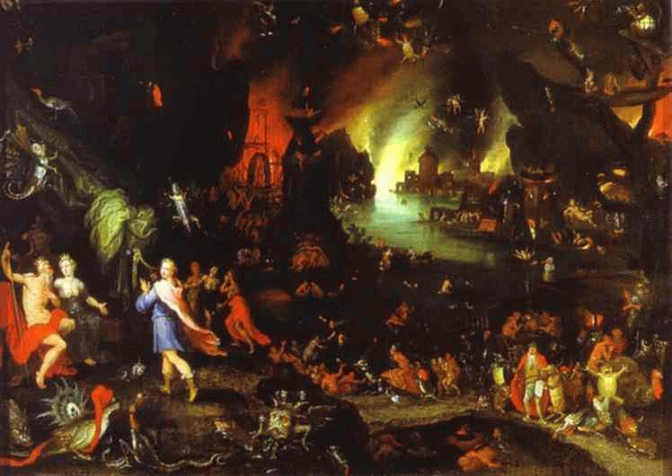
Journey to italy
Shipwrecked by Juno at Carthage
Retelling of the fall of Troy
Dido and Aeneas
Aeneas in the underworld
Notes:
Aeneas goes to Cumae, where the oracle takes him into the underworld to see his father Anchises
Anchises shows Aeneas the future of Rome, with figures like Julius Caesar and Augustus making an appearance (Virgil is writing in the age of Augustus, of course he has to include Augustus)

Slide 42
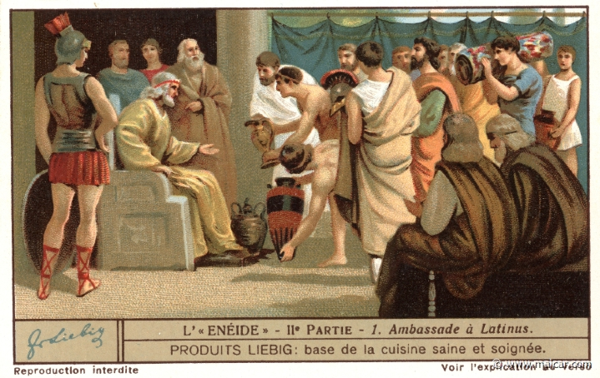
War in italy
Land in Latium
Aeneas vs. Turnus
Aeneas kills Turnus
Notes:
Latium is near Rome
Romans are welcomed by King Latinus
Latinus promises Aeneas his daughter Lavinia

Slide 43
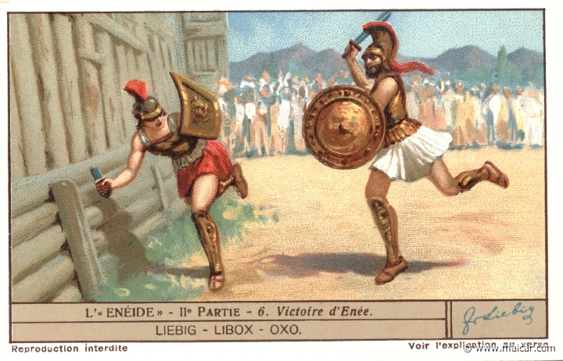
War in italy
Land in Latium
Aeneas vs. Turnus
Aeneas kills Turnus
Notes:
Prince Turnus also wants to marry Lavinia
Aeneas gets help from nearby King Evander
Extended battle scene with single combat between Aeneas and Turnus

Slide 44
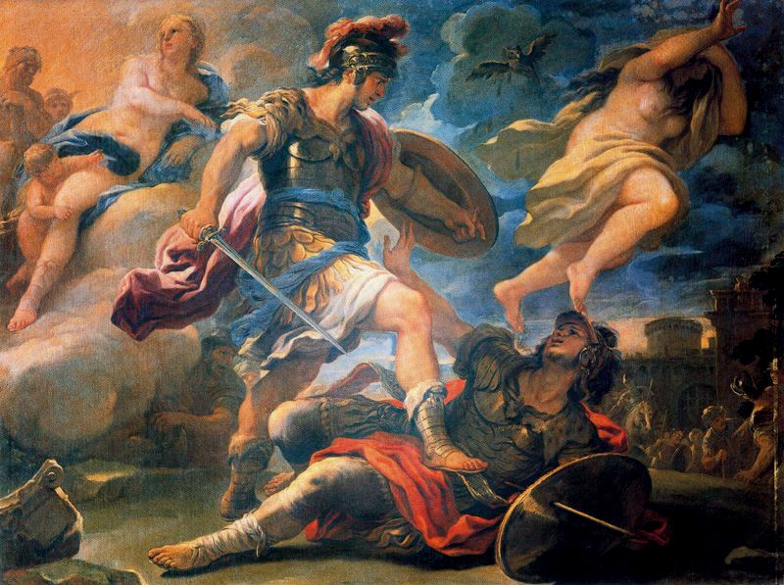
War in italy
Land in Latium
Aeneas vs. Turnus
Aeneas kills Turnus
Notes:
Aeneas has Turnus on the ground and sword point
Isn’t going to kill him until he sees that Turnus has the armor of Pallas, son of Evander and friend of Aeneas
An enraged Aeneas kills Turnus
Aeneas’s son, Iulus Ascanius, becomes king of Alba Longa
Establishes Julian Clan (Julius Caesar, Augustus)

Slide 45
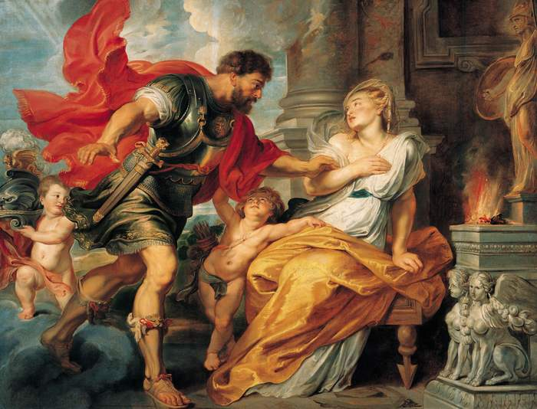
Romulus and remus
Rhea Silvia impregnated by Mars
Gives birth to twins, Romulus and Remus
Amulius throws twins in the Tiber
Saved and raised by she-wolf
Twins want to found a city
Romulus kills Remus
Rome is founded, Romulus king 753 BCE
Notes:
Rhea Silvia is the daughter of Numitor, king of Alba Longa
Remember Mars, god of war

Slide 46
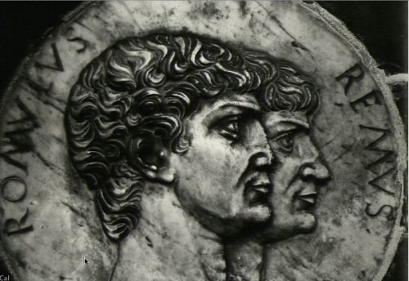
Romulus and remus
Rhea Silvia impregnated by Mars
Gives birth to twins, Romulus and Remus
Amulius throws twins in the Tiber
Saved and raised by she-wolf
Twins want to found a city
Romulus kills Remus
Rome is founded, Romulus king 753 BCE
Notes:
Amulius, Numitor’s brother, takes over
Rhea Silvia forced to become Vestal Virgin, meaning it would be improper for her to have children

Slide 47
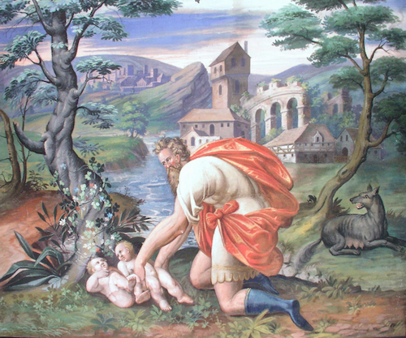
Romulus and remus
Rhea Silvia impregnated by Mars
Gives birth to twins, Romulus and Remus
Amulius throws twins in the Tiber
Saved and raised by she-wolf
Twins want to found a city
Romulus kills Remus
Rome is founded, Romulus king 753 BCE
Notes:
Amulius enraged when Rhea Silvia gives birth

Slide 48
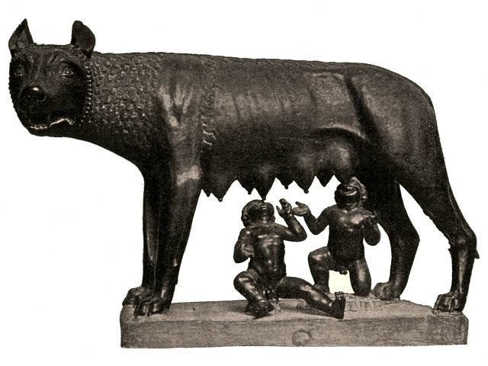
Romulus and remus
Rhea Silvia impregnated by Mars
Gives birth to twins, Romulus and Remus
Amulius throws twins in the Tiber
Saved and raised by she-wolf
Twins want to found a city
Romulus kills Remus
Rome is founded, Romulus king 753 BCE
Notes:
Later taken in by shepherd and his wife until adulthood
Here’s the wolf, very important symbol to the Romans

Slide 49
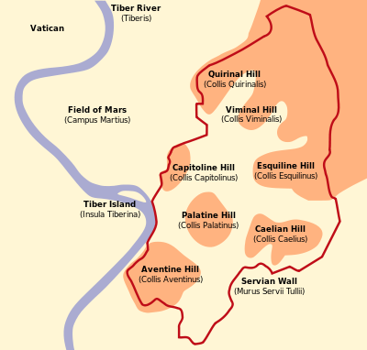
Romulus and remus
Rhea Silvia impregnated by Mars
Gives birth to twins, Romulus and Remus
Amulius throws twins in the Tiber
Saved and raised by she-wolf
Twins want to found a city
Romulus kills Remus
Rome is founded, Romulus king 753 BCE
Notes:
Twins natural leaders, many followers
Want to establish city rather than wait to inherit Alba Longa
Romulus wants Palatine Hill, Remus Aventine Hill (famous seven hills of Rome)
Agreed to interpret flight of birds to see who should build city, but disagreed about what they saw
Sidenote:
Romulus and Remus here acted as augurs, trying to read divine signs
Augurs were very important to the Romans, made decisions based off them
Look at flights of birds, organs of sacrificial animals (haruspicy) etc.

Slide 50
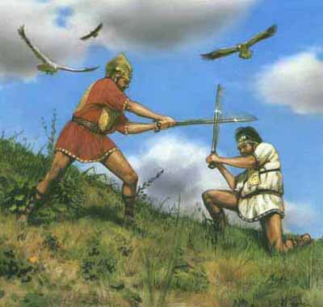
Romulus and remus
Rhea Silvia impregnated by Mars
Gives birth to twins, Romulus and Remus
Amulius throws twins in the Tiber
Saved and raised by she-wolf
Twins want to found a city
Romulus kills Remus
Rome is founded, Romulus king 753 BCE
Notes:
Comment: Roman history can be unfortunately violent, but the Romans were proud of this fact, which is why they believed they were descendants of Romulus, son of the god of war

Slide 51
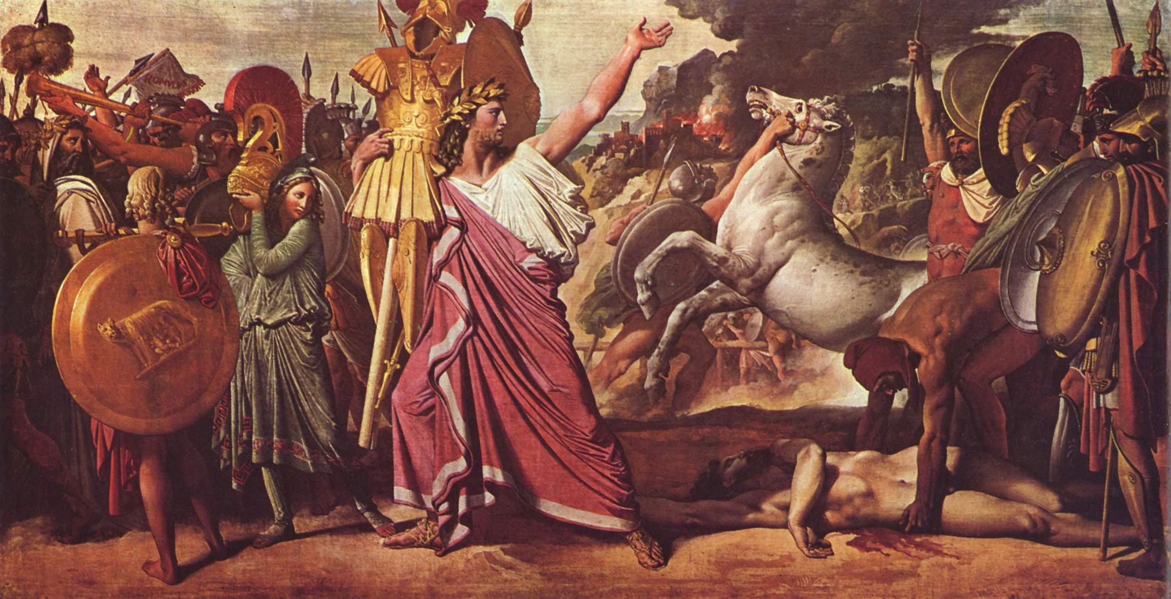
Romulus and remus
Rhea Silvia impregnated by Mars
Gives birth to twins, Romulus and Remus
Amulius throws twins in the Tiber
Saved and raised by she-wolf
Twins want to found a city
Romulus kills Remus
Rome is founded, Romulus king 753 BCE
Notes:
Romulus founds Rome and becomes its first king in 753 BCE (April 21)
Largely myth though, real founding not certain

Slide 52
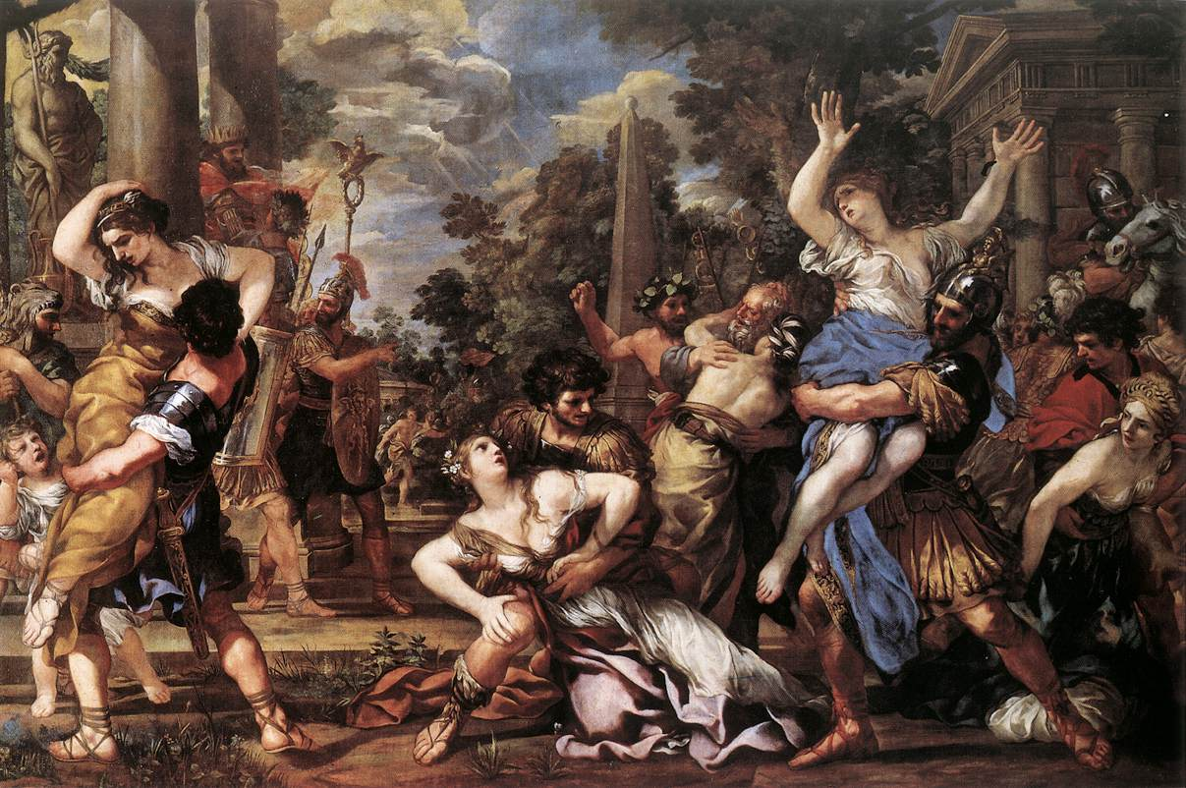
Seven Kings of rome
Romulus 753-715 BCE
Numa Pompilius 715-673
Tullus Hostilius 673-642
Ancus Marcius 642-617
Lucius Tarquinius Priscus 616-579
Servius Tullius 578-535
Lucius Tarquinius Superbus 534-510
Notes:
753 BCE thought by historians to be relatively accurate, but rest about kings is mostly uncertain/unknown
Rape of the Sabine Women 750 BCE
Rape refers to abduction of the women, used in a different sense than the word is used today
Romans invited nearby tribes to a festival
When they arrived, Romans jumped out and kidnapped Sabine women
How the Romans first got wives
Skip the next several kings because not much is known, though almost all were warlike began the process of expanding Rome’s power throughout Italy
Elected kings, different from typical monarchy where son is king, but still not a republic

Slide 53
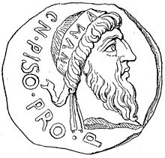
Seven Kings of rome
Romulus 753-715 BCE
Numa Pompilius 715-673
Tullus Hostilius 673-642
Ancus Marcius 642-617
Lucius Tarquinius Priscus 616-579
Servius Tullius 578-535
Lucius Tarquinius Superbus 534-510
Notes:
Elected kings, Pompilius didn’t even want to be king

Slide 54
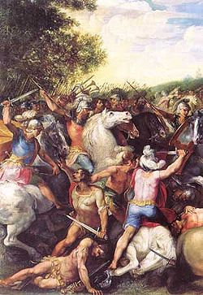
Seven Kings of rome
Romulus 753-715 BCE
Numa Pompilius 715-673
Tullus Hostilius 673-642
Ancus Marcius 642-617
Lucius Tarquinius Priscus 616-579
Servius Tullius 578-535
Lucius Tarquinius Superbus 534-510
Notes:
One fun story:
Didn’t care much for religious observances
Later became ill and tried to undertake sacrifices to Jupiter but failed to do them correctly
House struck by lightning, reduced to ashes

Slide 55
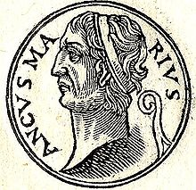
Seven Kings of rome
Romulus 753-715 BCE
Numa Pompilius 715-673
Tullus Hostilius 673-642
Ancus Marcius 642-617
Lucius Tarquinius Priscus 616-579
Servius Tullius 578-535
Lucius Tarquinius Superbus 534-510
Notes:
General wars against nearby tribes, slow expansion

Slide 56
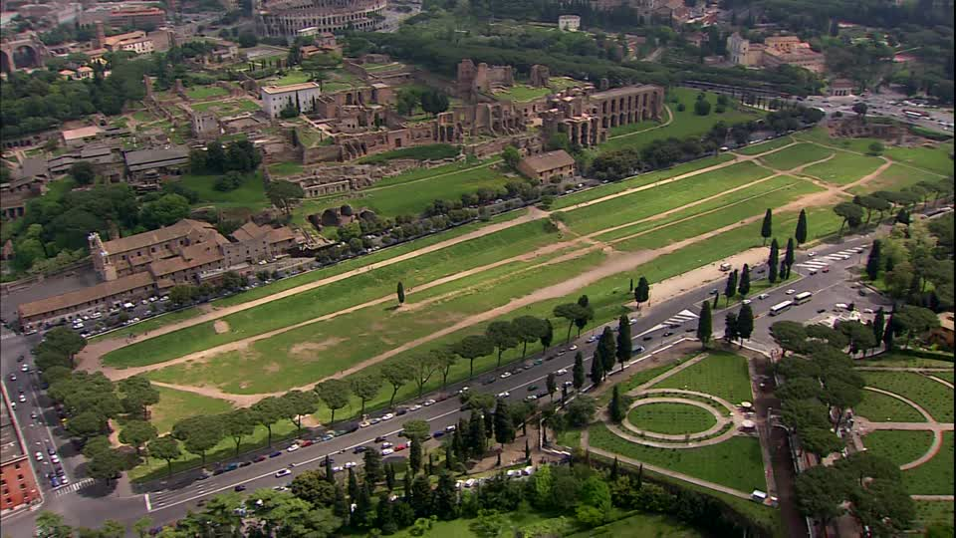
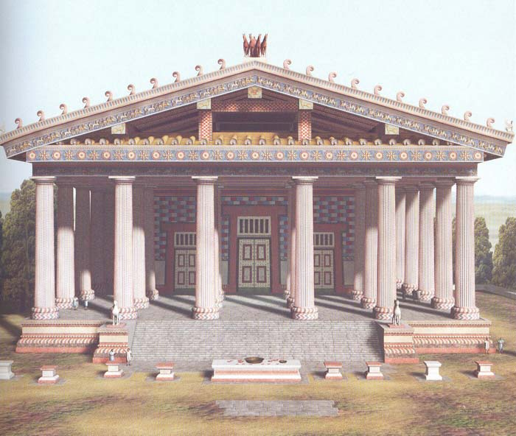
Seven Kings of rome
Romulus 753-715 BCE
Numa Pompilius 715-673
Tullus Hostilius 673-642
Ancus Marcius 642-617
Lucius Tarquinius Priscus 616-579
Servius Tullius 578-535
Lucius Tarquinius Superbus 534-510
Notes:
Two tarquins: this is Tarquin the Elder
Built some stuff:
Circus maximus (chariot races)
Temple of Jupiter
He and next two were Etruscan kings – importance of cultural interactions, Romans not entirely isolated

Slide 57
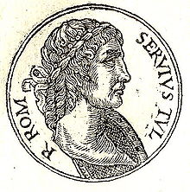
Seven Kings of rome
Romulus 753-715 BCE
Numa Pompilius 715-673
Tullus Hostilius 673-642
Ancus Marcius 642-617
Lucius Tarquinius Priscus 616-579
Servius Tullius 578-535
Lucius Tarquinius Superbus 534-510
Notes:
Census, which we still do (although not for all the same purposes) today (see next slide)

Slide 58
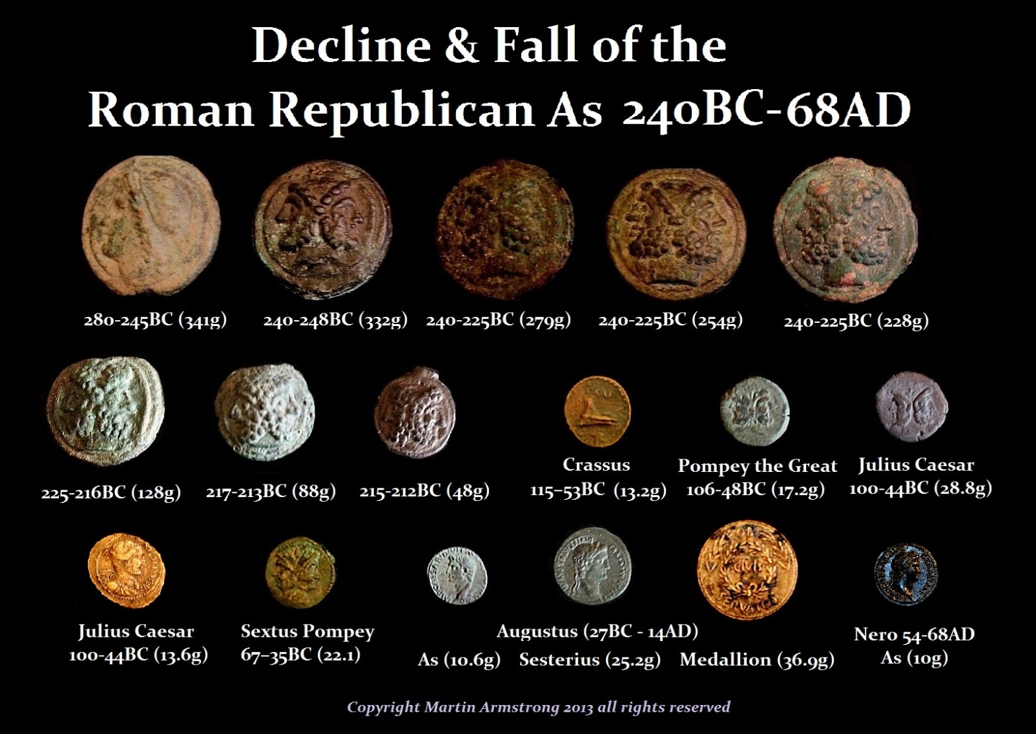
Roman census
Over 100,000 asses (monetary unit)
  80 centuriae
75,000 to 100,000 asses
  20 centuriae
50,000 to 75,000 asses
  20 centuriae
25,000 to 50,000 asses
  20 centuriae
11,000 to 25,000 asses
  30 centuriae
Under 11,000 asses
  1 century
Notes:
Ass is one of many types of coins, others include sistertius, denarius, aureus etc.
Century refers to 100 people (100 years), though centuries in reality had many more
Centuries were originally also a military unit, which century determined equipment, but later these centuries were only for voting
Each century had one vote, which was decided by majority vote within the century
Clearly the wealthy had many more centuriae, so they had a much greater say
Vote from richest to poorest until an overall majority, so often poorest never even got to voice their opinion
Still impressive that they gave all people a say in government, our democracy is very much based on the Roman Republic, although we elect representatives who do all the voting, whereas Roman citizens would vote on individual issues

Slide 59
Seven Kings of rome
Romulus 753-715 BCE
Numa Pompilius 715-673
Tullus Hostilius 673-642
Ancus Marcius 642-617
Lucius Tarquinius Priscus 616-579
Servius Tullius 578-535
Lucius Tarquinius Superbus 534-510
Notes:
Murdered by daughter Tullia and son-in-law Tarquinius Superbus

Slide 60
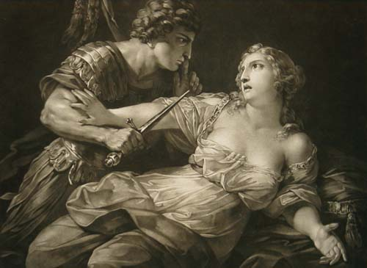
Seven Kings of rome
Romulus 753-715 BCE
Numa Pompilius 715-673
Tullus Hostilius 673-642
Ancus Marcius 642-617
Lucius Tarquinius Priscus 616-579
Servius Tullius 578-535
Lucius Tarquinius Superbus 534-510
Notes:
Tarquin the Proud
Most famous for his overthrow
Rape of Lucretia in 509 BCE
Sextus Tarquinius, son of Tarquin the Proud, threatened to kill Lucretia if she didn’t give in to him
Lucretia did so also to avoid him claiming she committed act of adultery with a slave
She told her husband and family everything and then committed suicide out of shame
Tribune Brutus inflamed people b/c of Lucretia, expelled Tarquin, became first consul along with Collatinus
Ask if anyone knows any famous Brutus’s from Roman history, ask what that Brutus did
Brutus who killed Caesar claimed relation to this Brutus from hundreds of years earlier b/c believed he was overthrowing a tyrant

Slide 61
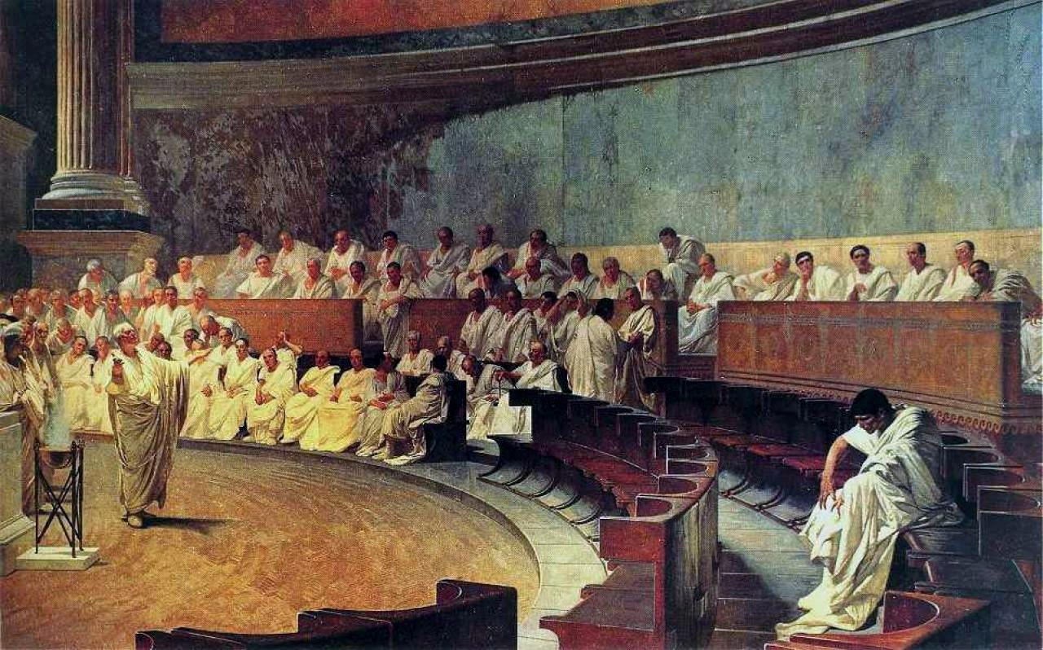
Roman Republic (510-27 BCE)
Early-mid Republic (510-264 BCE)
  Cursus Honorum
  The Twelve Tables
  Roman Values
  Conflict of the Orders
  Expansion in Italy
  War with Pyrrhus

Slide 62
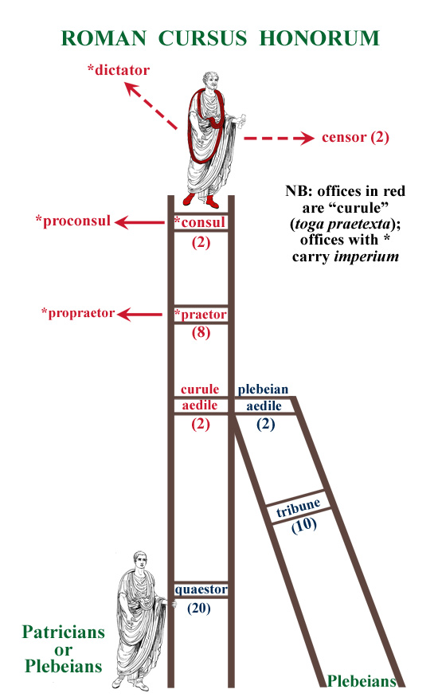
Cursus honorem
Quaestor
Tribune
Aedile
Praetor
Consul
Dictator
Notes:
Sequence of offices – not this rigid in early republic but developed over time
All (except dictator) elected for a year
Quaestor – accountants in charge of the treasury
Aedile – responsible for Roman games and for maintenance of the temples
Tribune – protect the people against oppression
Praetor – responsible for administration of justice
Consul – equivalent of president or prime minister, two of them/make laws, lead armies, preside over senate
Dictator – appointed in times of crisis for six months, absolute power, here in perpetuity
After serving for a year, one would become a senator – senate was advisory body, didn’t actually pass laws

Slide 63
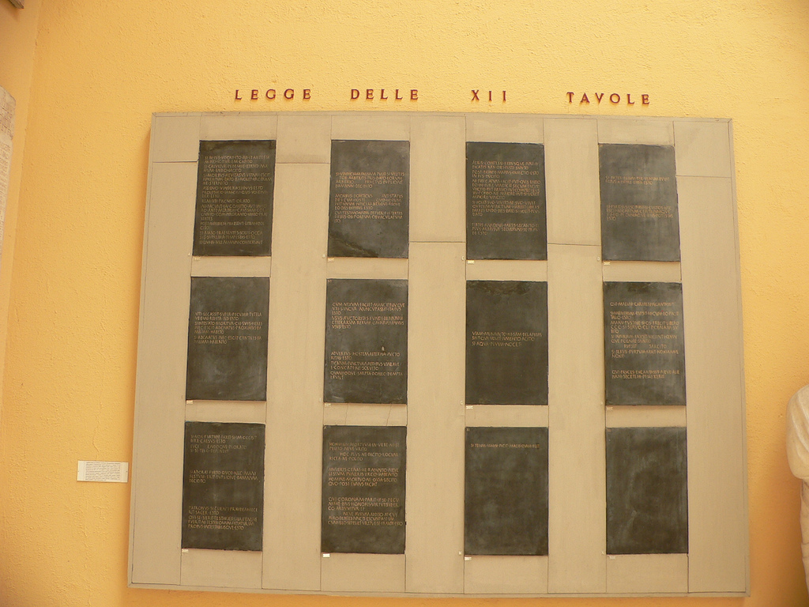
The twelve tables
Early republic (5th century BCE)
Consuls too powerful
Drafted in 450 BCE by decemvirs
Not full law code
Notes:
Fundamental Roman laws, similar to Constitution though less about form of government and more about rights

Slide 64

The twelve tables
Early republic (5th century BCE)
Consuls too powerful
Drafted in 450 BCE by decemvirs
Not full law code
Notes:
Senatus populusque Romanus (Senate and people of Rome, SPQR)

Slide 65
The twelve tables
Early republic (5th century BCE)
Consuls too powerful
Drafted in 450 BCE by decemvirs
Not full law code
Notes:
Decemvirs is a group of ten men
For a year given more power than the consuls in order to write these laws
Second set of decemvirs was needed the next year to finish the laws

Slide 66
The twelve tables
Early republic (5th century BCE)
Consuls too powerful
Drafted in 450 BCE by decemvirs
Not full law code
Notes:
These laws give an outline for how Roman society should function but are only a basis off of which many other laws are created

Slide 67
The twelve tables
Table | Section of law
I | Procedure: for courts and trials
II | Trials, continued
III | Debt
IV | Rights of fathers (paterfamilias) over the family
V | Legal guardianship and inheritance laws
VI | Acquisition and possession
VII | Land rights
VIII | Torts and delicts (Laws of injury)
IX | Public law
X | Sacred law
XI | Supplement I
XII | Supplement II
Notes:
If time, briefly discuss Roman numerals
Ask people to give Roman numerals
I, V, X, L, C, D, M
WRITE OUT (maybe)
Debt is a very important part of the laws
30 days to pay creditor, if fail then creditor could seize him, bring him to Forum on three days, if still not pay then sell into slavery (note difference btw. Roman slavery based on conquest, debt and American slavery based on race/better though not great treatment, possibility of freedom)

Slide 68
Law of twelve tables
VIII. 1 "If any person has sung or composed against another person a SONG (carmen) such as was causing slander or insult.... he shall be clubbed to death.“
Notes:
Other examples of laws
First one a little humorous

Slide 69
Law of twelve tables
VIII. 1 "If any person has sung or composed against another person a SONG (carmen) such as was causing slander or insult.... he shall be clubbed to death.“
VIII. 23 "Whoever is convicted of speaking false witness shall be flung from the Tarpeian Rock.“
Notes:
Picture next slide

Slide 70
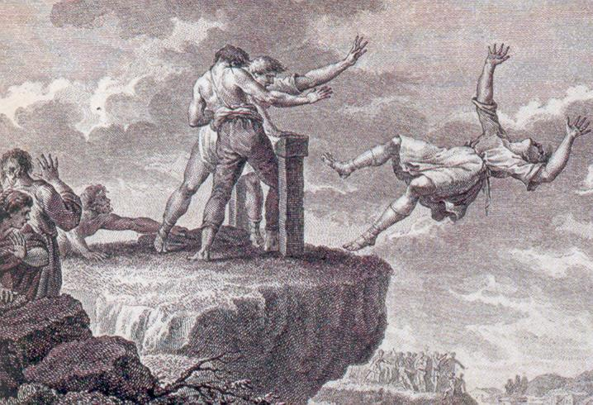
Law of twelve tables
VIII. 1 "If any person has sung or composed against another person a SONG (carmen) such as was causing slander or insult.... he shall be clubbed to death.“
VIII. 23 "Whoever is convicted of speaking false witness shall be flung from the Tarpeian Rock.“
Notes:
We’re not as harsh today, but we still have punishments for perjury

Slide 71
Law of twelve tables
VIII. 1 "If any person has sung or composed against another person a SONG (carmen) such as was causing slander or insult.... he shall be clubbed to death.“
VIII. 23 "Whoever is convicted of speaking false witness shall be flung from the Tarpeian Rock.“
IX. 6 "Putting to death... of any man who has not been convicted, whosoever he might be, is forbidden.“
Notes:
Basis for innocent until proven guilty, a foundation of our modern criminal justice system

Slide 72
Law of twelve tables
VIII. 1 "If any person has sung or composed against another person a SONG (carmen) such as was causing slander or insult.... he shall be clubbed to death.“
VIII. 23 "Whoever is convicted of speaking false witness shall be flung from the Tarpeian Rock.“
IX. 6 "Putting to death... of any man who has not been convicted, whosoever he might be, is forbidden.“
XII. 5 "Whatever the People has last ordained shall be held as binding by law."
Notes:
Indication that the Twelve Tables are not the entire law code, the people make more laws

Slide 73
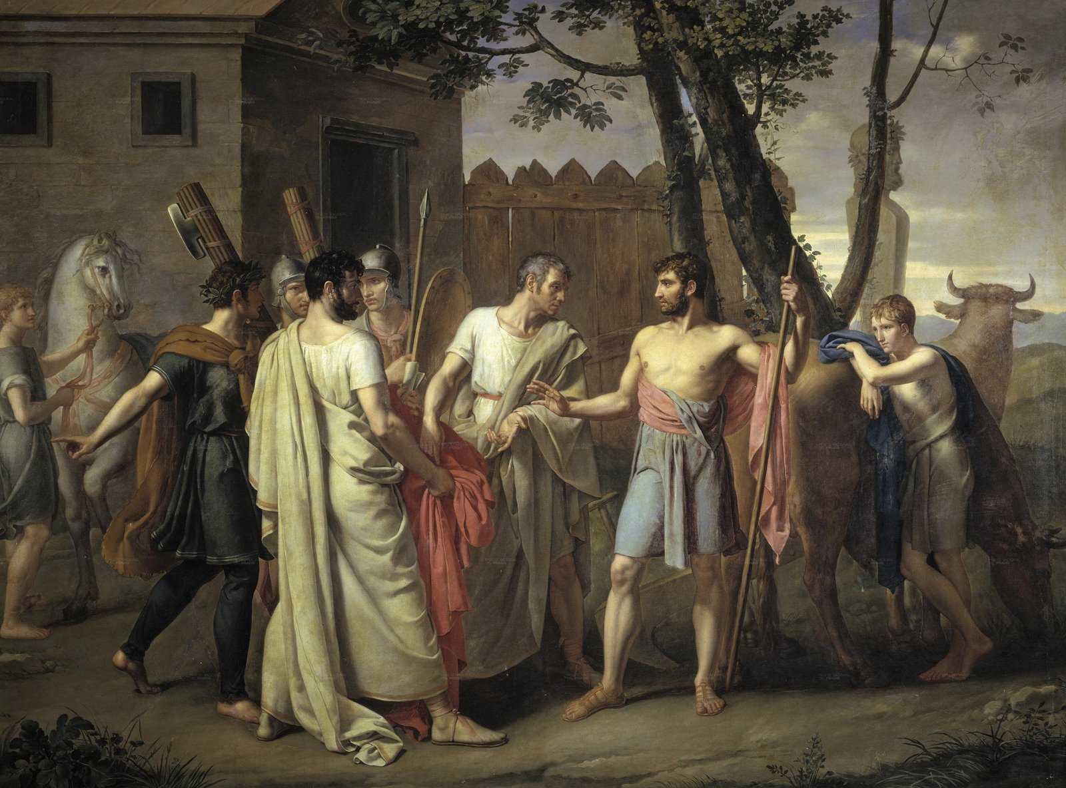
Roman values
Cincinnatus
  Roman aristocrat
  Consul 460 BCE
  War with Aequi and Sabines
  Dictatorship
  Relinquishment of power
Notes:
Lucius Quinctius Cincinnatus

Slide 74
Roman values
Cincinnatus
  Roman aristocrat
  Consul 460 BCE
  War with Aequi and Sabines
  Dictatorship
  Relinquishment of power
Notes:
Returned to his farm afterwards

Slide 75
Roman values
Cincinnatus
  Roman aristocrat
  Consul 460 BCE
  War with Aequi and Sabines
  Dictatorship
  Relinquishment of power
Notes:
Rome fights while he is happily tending to his land

Slide 76
Roman values
Cincinnatus
  Roman aristocrat
  Consul 460 BCE
  War with Aequi and Sabines
  Dictatorship
  Relinquishment of power
Notes:
Romans convince him to become dictator
Given absolute power for six months

Slide 77
Roman values
Cincinnatus
  Roman aristocrat
  Consul 460 BCE
  War with Aequi and Sabines
  Dictatorship
  Relinquishment of power
Notes:
Defeats the Aequi and Sabines in two weeks
More importantly, he immediately relinquishes power to return to his farm
Romans liked to tell the story because they disliked the power hungry (though many Romans later on certainly were power hungry)
US has similar values:
Ask if anyone can think of a similar figure in American history
Washington wanted to return to his farm after Revolutionary War but convinced to become president, served two terms but refused to serve more b/c didn’t want to die in office as though a king, preferred to pass power to someone else

Slide 78
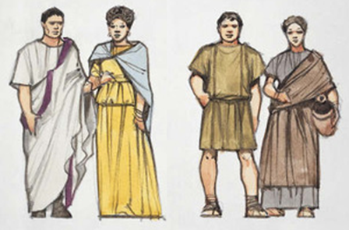
Conflict of the orders
Patricians vs. plebeians
Used “secession” to get their way
Tribune of the plebs (490s BCE)
Notes:
Patricians were wealthy from specific families, plebeians others so many poor but some quite wealthy, just not patricians b/c not born into the right family
Many more plebeians
In early Republic patricians hold all political and religious offices

Slide 79
Conflict of the orders
Patricians vs. plebeians
Used “secession” to get their way
Tribune of the plebs (490s BCE)
Notes:
In order to make the patricians give them what they want, plebian members of the army would withdraw to hill outside Rome, choose own leaders, refuse to cooperate until grievances addressed

Slide 80
Conflict of the orders
Patricians vs. plebeians
Used “secession” to get their way
Tribune of the plebs (490s BCE)
Notes:
Major gain was a tribune of the plebians to protect the plebeians
Eventually became very powerful position
Protect individuals, block official actions (veto), convene senate, propose legislation
Later allowed to take other offices in cursus honorum and even become consul

Slide 81
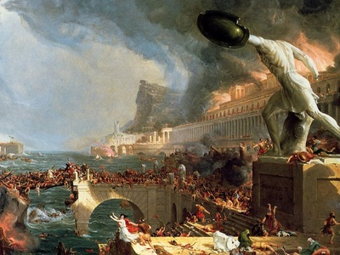
Expansion in italy
Setback: Sack of Rome (387 BCE)
First Samnite War (343-341 BCE)
Latin War (341-338 BCE)
Second Samnite War (326-304 BCE)
Third Samnite War (298-290 BCE)
Notes:
Period of minor expansion in central Italy, then setback when Gauls sacked Rome
Rome not sacked again for 800 years
Story of senators who refused to leave and remained in seats as though statues until Gaul touched one’s beard, senator hit him with staff, senators killed
Story: would have been worse if sacred geese of Juno hadn’t given the alarm that Gauls were coming
Numerous wars against their neighbors in order to expand their influence
When a neighbor is conquered, they weren’t made a part of Rome but were usually left some independence and were simply made an ally
Those conquered had to provide soldiers for Rome’s army (some had to pay tribute) but were guaranteed protection by Rome
Allowed Rome to expand in a way city-states of Greece couldn’t b/c they remained fiercely independent
Diversion about Roman military formation
Map of expansion next slide

Slide 82
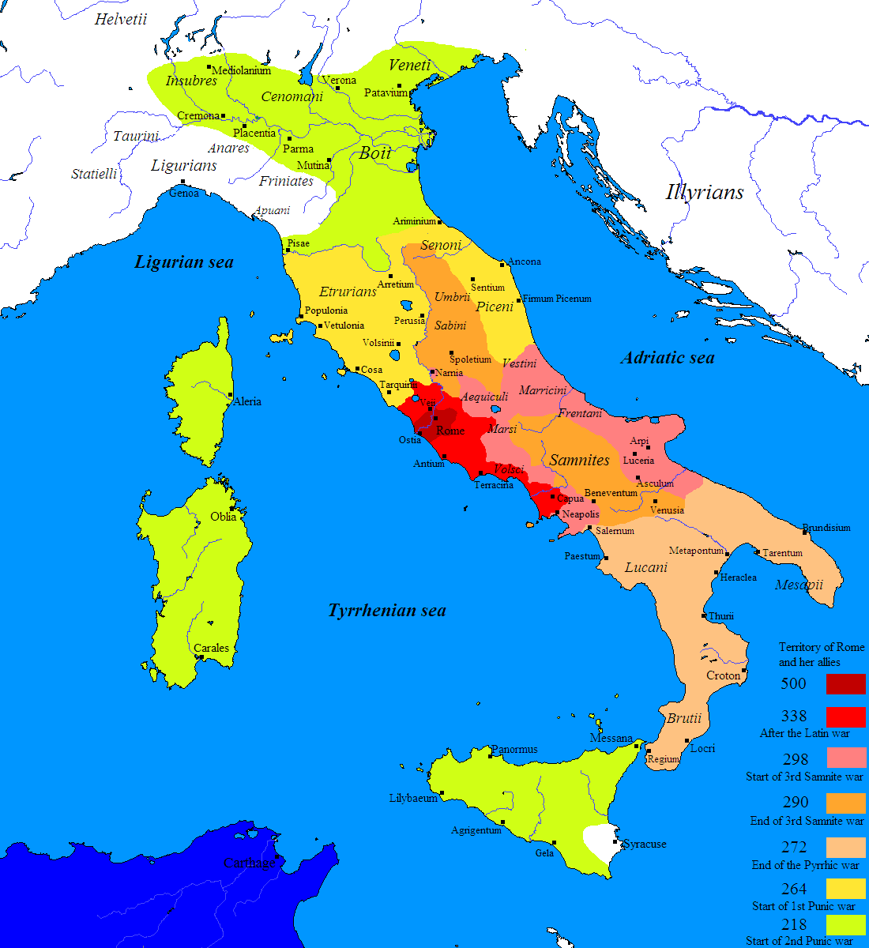

Slide 83
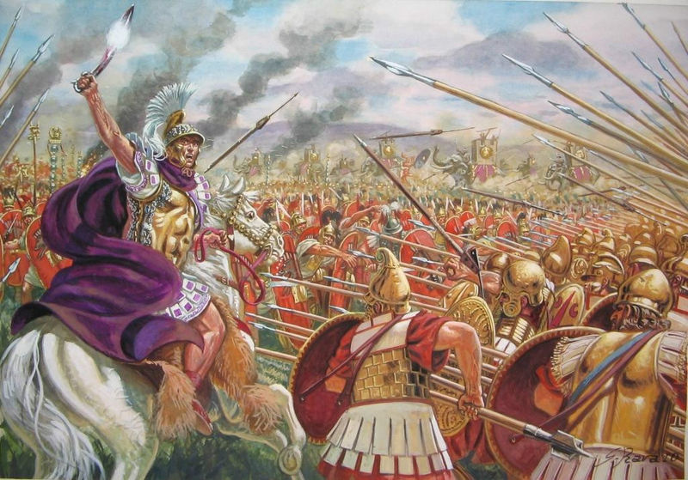
War with pyrrhus
Tarentum besieged by Romans 281 BCE
Ask King Pyrrhus of Epirus for help
Pyrrhic victory
  “Another such victory and I shall be ruined”
Notes:
Romans expanding so attack Greek city if Tarentum

Slide 84
War with pyrrhus
Tarentum besieged by Romans 281 BCE
Ask King Pyrrhus of Epirus for help
Pyrrhic victory
  “Another such victory and I shall be ruined”
Notes:
Tarentum asks King Pyrrhus of Epirus from across the Adriatic Sea for assistance

Slide 85
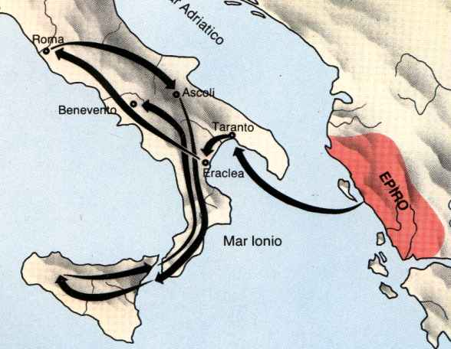
Notes:
First stage: Pyrrhus crosses Adriatic (from modern day Albania)
20,000 infantry, 3,000 cavalry
Defeats the Romans at Battles of Heraclea and Asculum
However, not an ideal victory

Slide 86
War with pyrrhus
Tarentum besieged by Romans 281 BCE
Ask King Pyrrhus of Epirus for help
Pyrrhic victory
  “Another such victory and I shall be ruined”

Slide 87
Notes:
Second stage: proceeds toward Rome but driven away
Eventually Tarentum surrendered when Pyrrhus abandoned Italy in 275 BCE
Sidenote: Pyrrhus died when parading through a city and an old woman threw a roof tile at his head
This wraps up early Republic and end of class

Slide 88
Class 1 conclusion
The Founding of Rome, the Kings, and the Establishment of the Republic (753-264 BCE)
  Founding myths:
    The Aeneid
    Romulus and Remus
  The Kings of Rome
  Life in the Republic
  Expansion in Italy
Notes:
Reminder of what we’ve covered this class (500 years!)
Next slide is hint at what’s coming next

Slide 89
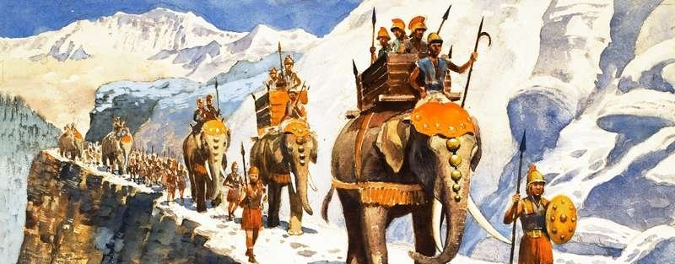
Notes:
Preview of next week
Try to figure out what it is

Slide 90
sources
The Romans: From Village to Empire
Classical Literature: A Very Short Introduction
The Roman Republic: A Very Short Introduction
Wikipedia
http://www.vox.com/2014/8/19/5942585/40-maps-that-explain-the-roman-empire
http://www.nativlang.com/romance-languages/romance-tables-syntax.php?tableName=syntax1
http://www.britannica.com/topic/Vulgar-Latin
http://www.roman-empire.net/children/gods.html
http://www.csun.edu/~hcfll004/12tables.html
http://literacy.kent.edu/Minigrants/Cinci/romanchart.htm
Google images

